Slide 1
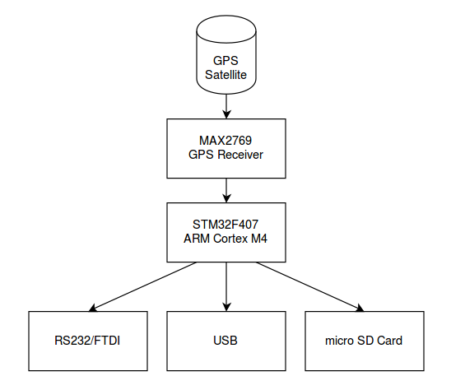
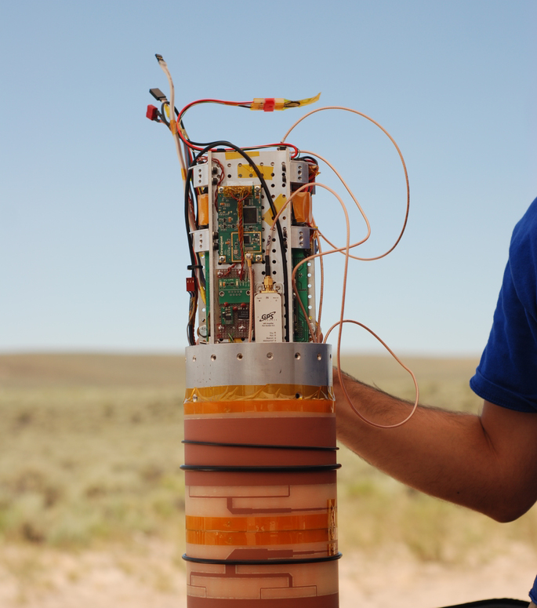
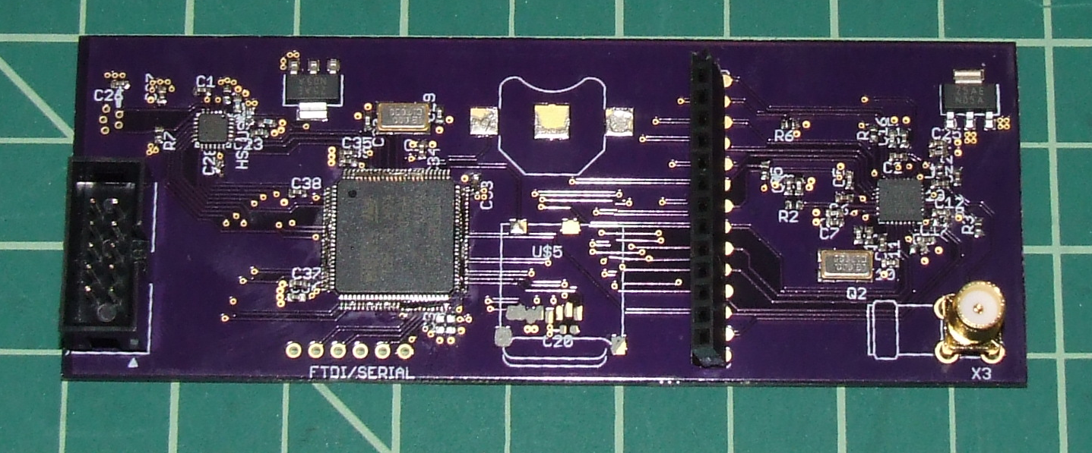
Universal GPS RF Front-end Board
Jenner Hanni, MEng, ECE
Summary
Implementation
This is an open source, hand held device that makes raw GPS satellite data available for the development of custom receivers.
Powered by either a 3.3V Coin cell battery or 5V DC power over USB from a laptop.
The data stream is available over USB, serial, or directly to the micro SD card.
STM32F407 is an ARM Cortex M4 chip.
MAX2769 GPS Receiver chip supports a powered or unpowered antenna.
The STM32F407 is a newer chip with extensive documentation and a hobbyist developer community.
All schematics and software are open source so the board can be modified.
Total component cost is under $100.
Claim
GPS receivers turn the reference data from the satellites into an absolute position. Making new and better GPS receivers is good for both consumer product development and academic research with applications from medical devices to autonomous vehicles.
There are many techniques that can be used in the GPS receivers but developers need the raw I and Q signals from a front-end board.
Current boards are closed-source, don't make enough streaming data available or allow for enough of it to be saved, and in any case are prohibitively expensive.
Figure 1. Data path from satellite to user.
Requirements
Mobile, hand-held. Low cost with readily available components. Multiple ways to save the data and platform independent.
Open source schematics and software.
Collaborators
Bart Massey, Andrew Greenberg and
the Portland State Aerospace Society.
Source code and schematics available at
http://github.com/wicker/
Figure 2. Hardware prototype.
Figure 3. Rocket avionics module

Slide 2
Hardware

